Slide 1

ECE 2595 Project 2: Option 2
Madison Hodgson
Avery Peiffer

Slide 2
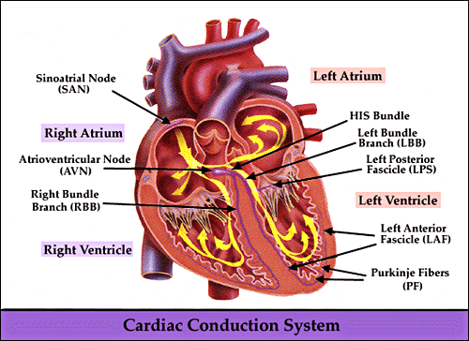
Normal Sinus Rhythm
Business as usual
Impulse in SA/SAN node
Propagates through atria to AV/AVN node
Bundle of His activates, which leads to the Purkinje Fibers
PF provide conduction to ventricles, causing them to contract and pump blood
[1]

Slide 3
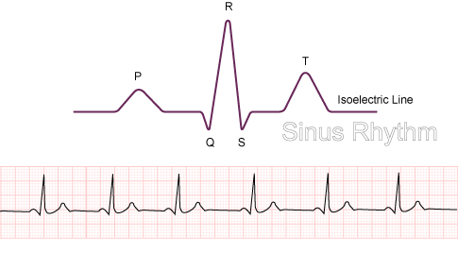
Normal Sinus Rhythm (cont.)
Let’s use this as a basis for comparing the various abnormal heart conditions
Expressed as PQRST waveform that we are familiar with
P: atrial depolarization
QRS: ventricular depolarization (ventricles are contracting)
T: ventricular repolarization (ventricles are relaxing)
[2]

Slide 4
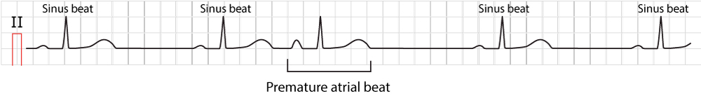
Atrial Premature Beat
What happens: extra heartbeat before next QRS wave
Atria gets an electrical stimulation between heart beats, causing SD node to fire and go through another rhythm between two normal heartbeats
Not problematic in isolation, but can signal related heart conditions if occurring frequently (cardiomyopathy, coronary heart disease)
[3]

Slide 5
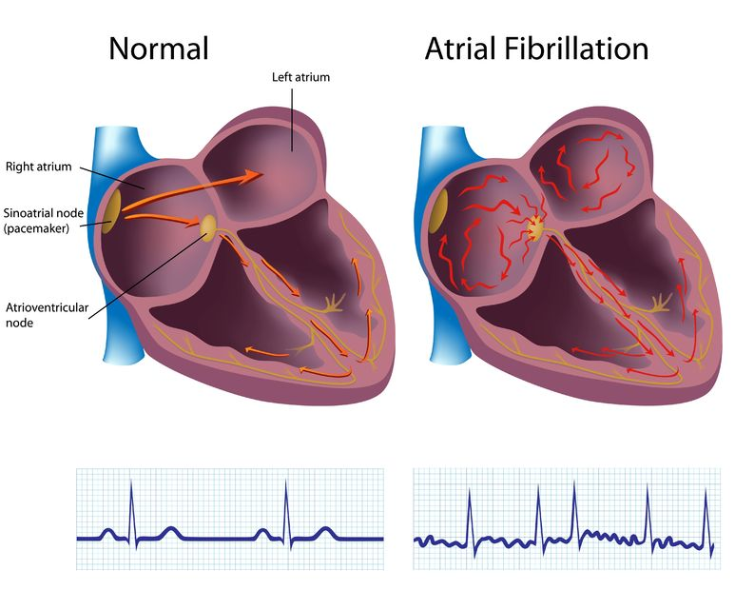
Atrial Fibrillation
What happens: atria quiver (disorganized contraction) which can lead to no blood being pumped
Heart receives electrical signals from outside the SA node. The contraction of the atria and ventricles is no longer connected. Blood can pool inside the heart.
Single episode usually isn’t life threatening, but requires treatment to prevent stroke and heart failure
[4]

Slide 6
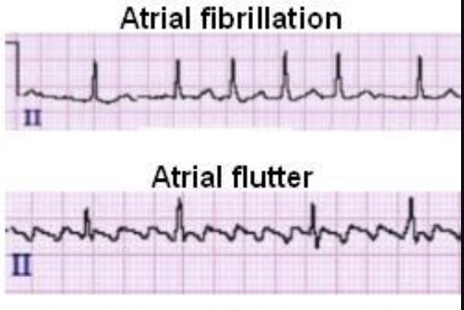
Atrial Flutter
What happens: rapid heart beats that stop chambers from filling completely between beats
SD node is constantly firing which causes the heart to send signals to keep beating without any rhythm
Less serious than atrial fibrillation because it is less likely to form clots
[5]

Slide 7
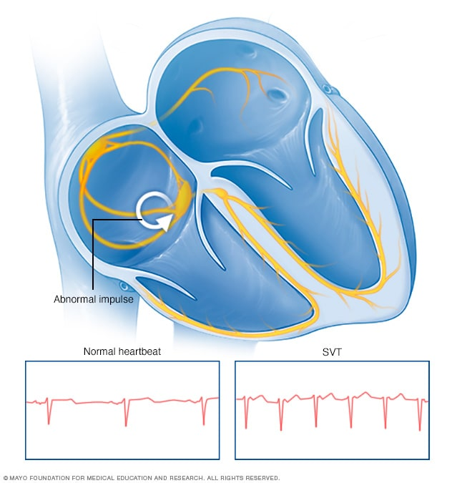
Supraventricular Tachyarrhythmia
What happens: faster than normal heart rate
Normal electrical impulses in the heart are disrupted above the ventricles (typically Atria)
Not enough oxygen is being pumped (may feel dizzy or light-headed)
May weaken the heart and lead to heart failure
[6]

Slide 8
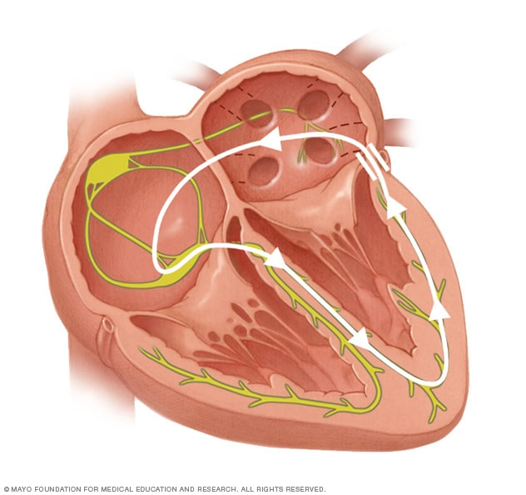
Pre-excitation: Wolff-Parkinson-White Syndrome (WPW)
What happens: rapid heart rate that can also be sporadic (can also have A-Fib)
Present at birth, there is an extra connection that connects upper atria to the lower ventricles
Transmits more excitation signals to ventricle than back to atria
(Rarely) can lead to sudden cardiac death
[7]

Slide 9
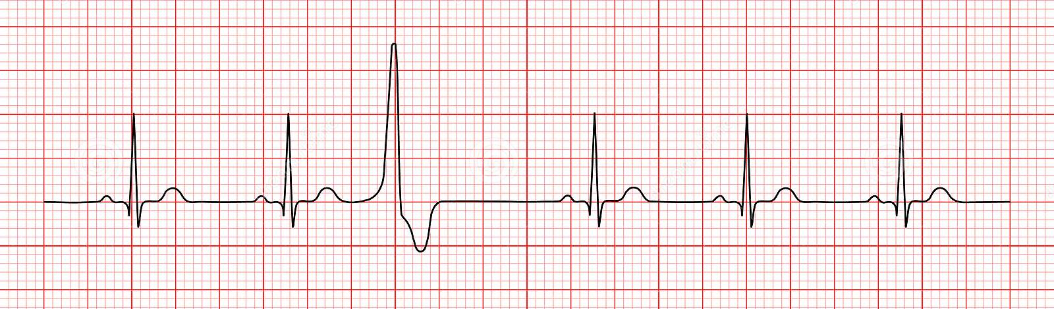
Premature Ventricular Contraction (PVC)
What happens: extra heartbeats that begin in one of the ventricles
Cells in the ventricles become electrically unstable from external factors
Frequent PVCs can increase the risk of developing arrythmia or cardiomyopathy
[8]

Slide 10
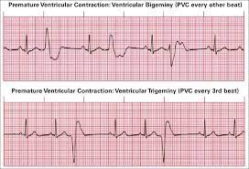
Ventricular Bigeminy, Ventricular Trigeminy
What happens: PVC occurs every other beat (bigeminy) or every third beat (trigeminy)
Could be caused by an electrolyte imbalance or overactive thyroid
[9]

Slide 11
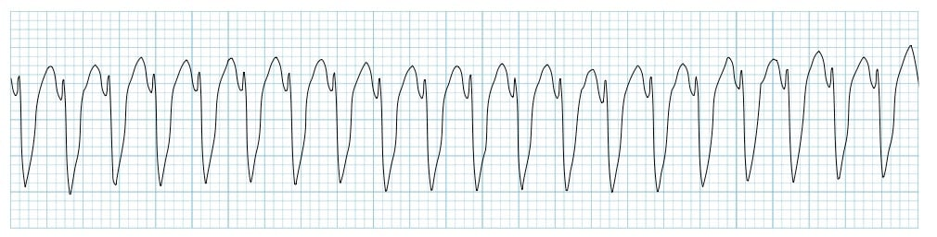
Ventricular Tachycardia
What happens: heart beats too fast and is abnormal
Usually, heart has been damaged, and scar tissue creates abnormal electrical pathways in ventricles
Alternatively, normal impulse to ventricle fails to die out after ventricle contracts
Can lead to ventricular fibrillation and cardiac arrest
[10]

Slide 12
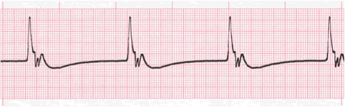
Idioventricular Rhythm
What happens: very slow heart rhythm
SA node is blocked or suppressed, so ventricle creates a rhythm of its own to keep the heart beating
No P waves since atria are being blocked, QRS interval is extended
Typically, less than 50 bpm
[11]

Slide 13
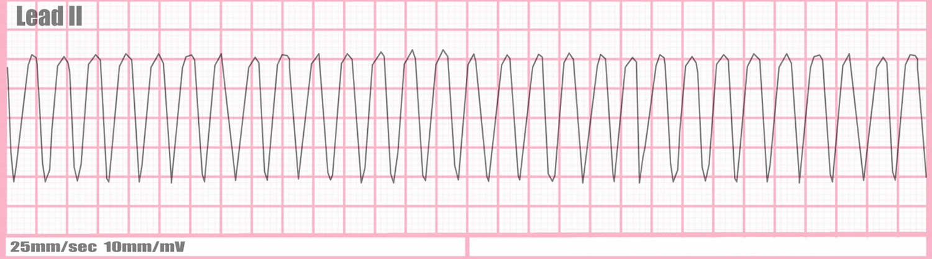
Ventricular Flutter
What happens: fast heart rate that can’t sustain any blood pumping
Need immediate life support to prevent death
Caused by extreme ventricular tachycardia, so there are no organized signals in the ventricle
Cells are exciting at totally different times in the ventricle, so heartbeat just looks like a sine wave
[12]

Slide 14
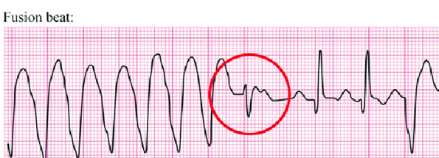
Fusion of Ventricular and Normal Beat
What happens: heart doesn’t beat in a normal QRS pattern
Atria sends signal as normal, but there is also a signal originating in ventricle
Causes QRS to become merged
Typically benign
[13]

Slide 15
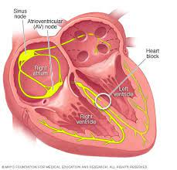
Left/Right Bundle Branch Block Beat
What happens: Each heartbeat pushes out less blood and is slightly irregular (ventricles contract at slightly different times)
One bundle that carries signal from AV node to ventricle is blocked
Ventricle on blocked side instead gets excited by electrical signal from opposite ventricle
Treated by managing underlying cause of blockage
[14]

Slide 16
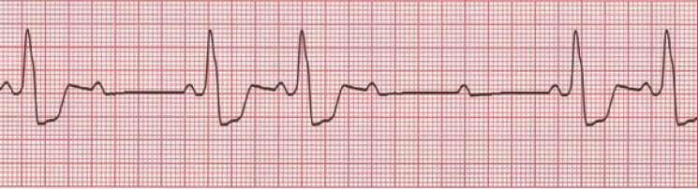
Second Degree Heart Block
What happens: AV node is blocked, and electrical impulse can’t send signal effectively to ventricles
Impulses are intermittently blocked, so heartbeat slows or skips
Type I: Electrical signal through AV gets slower and then heartbeat is skipped occasionally (less serious)
Type II: Most signals reach your ventricle but sometimes they don’t reach the ventricle at all (heartbeat becomes irregular)
[15]

Slide 17
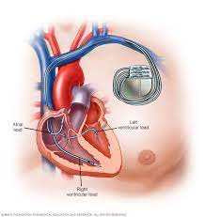
Pacemaker Rhythm
What happens: Heart beating is controlled by a pacemaker implanted into the atria or ventricles
Pacemaker leads send electrical impulse to atria or ventricles which start the heartbeat
Only sends signals if heartbeat slows down
Temporary implants after heart attack/surgery, permanent implants to correct chronic irregular heartbeat
[16]

Slide 18

Special Thanks!
https://www.cedars-sinai.org/

Slide 19
References
[1] https://www.frca.co.uk/article.aspx?articleid=100682
[2] https://www.nottingham.ac.uk/nursing/practice/resources/cardiology/function/sinus_rythm.php
[3] https://litfl.com/premature-atrial-complex-pac/
[4] https://www.oliversegal.com/heart-conditions/atrial-fibrillation-atrial-flutter/
[5] https://www.healio.com/cardiology/learn-the-heart/ecg-review/ecg-topic-reviews-and-criteria/atrial-flutter-review
[6] https://www.mayoclinic.org/diseases-conditions/supraventricular-tachycardia/symptoms-causes/syc-20355243
[7] https://www.mayoclinic.org/diseases-conditions/wolff-parkinson-white-syndrome/symptoms-causes/syc-20354626
[8] https://cardiorhythm.co.za/premature-ventricular-contractions/
[9] https://litfl.com/ventricular-tachycardia-monomorphic-ecg-library/
[10] https://ekg.academy/lesson/1035
[11] https://healthjade.net/ventricular-flutter/
[12] https://www.researchgate.net/figure/Capture-and-fusion-beats_fig3_284879613
[13] https://www.mayoclinic.org/diseases-conditions/bundle-branch-block/symptoms-causes/syc-20370514
[14] https://litfl.com/av-block-2nd-degree-mobitz-ii-hay-block/
[15] https://www.mayoclinic.org/tests-procedures/pacemaker/about/pac-20384689

